Slide 1


VEHICLE ACCIDENT AVOIDING SYSTEM USING GSM-GPS TECHNOLOGY
Prepared By:
MEET PATEL : 1620BEEC30025
Group No: 03
Kadi Sarva Vishwavidyalaya
LDRP Institute of Technology & Research, Gandhinagar
Electronics & Communication Engineering Department
July-2019

Slide 2
PRESENTATION OUTLINE
What is GPS?
How GPS work?
What is GSM?
architecture of GSM
Project overview
Block diagram
Circuit diagram
Arduino uno
Features of Arduino uno
Pin diagram of atmega328
MQ-3 sensor
Features of MQ-3 sensor
Pin description of MQ-3 sensor

Slide 3
MQ-3 interfacing with Arduino Uno
GSM800C module
Features of GSM800c
Eye blink sensor
TCRT5000(reflective optical sensor with transistor output)
Proteus simulation output
Hardware output
Future scope
Application
conclusion

Slide 4
WHAT IS GPS?
It Stands for global positioning system.
The GPS concept is based on time and the known position of GPS specialized satellites.
The satellite carry stable atomic clocks that are synchronized with one another and with the ground clocks.
The Global Positioning System (GPS) is a satellite-based navigation system made up of at least 24 satellites
The U.S. Department of Defense (USDOD) originally put the satellites into orbit for military use, but they were made available for civilian use in the 1980s.

Slide 5
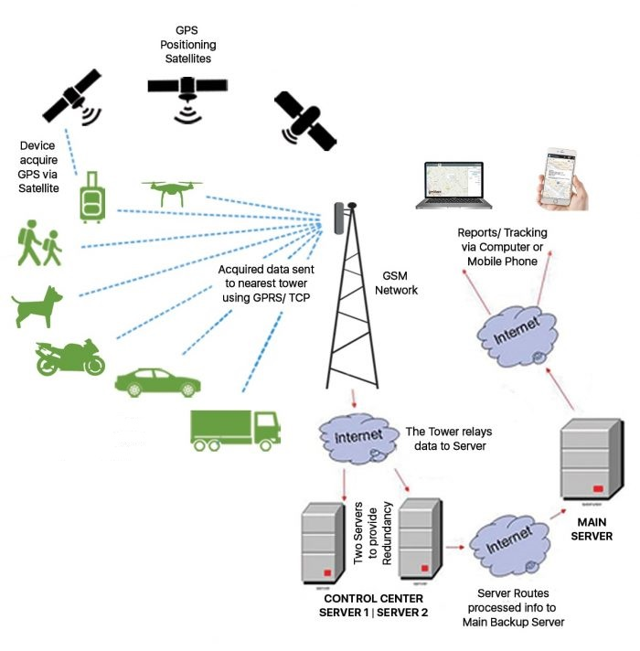
HOW GPS WORK?

Slide 6
WHAT IS GSM?
It is stands for global system for mobile communication
This standard is developed by European Telecommunications standards institute to describe the protocols for second generation digital cellular networks used by mobile devices such as phones and tablets.
It was first deployed in Finland in December 1991. by the mid-2010s,it became a global standard for mobile communications achieving over 90% market share and operating in over 193 countries and territories.

Slide 7
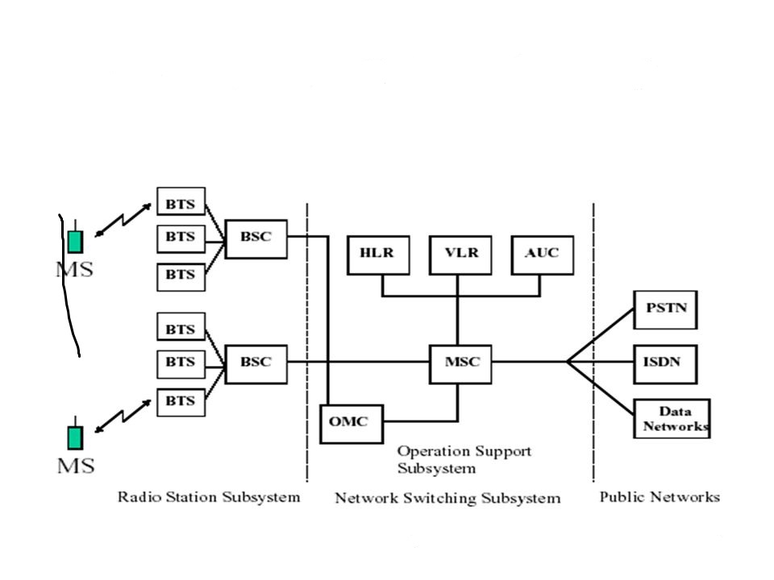
ARCHITECTURE OF GSM

Slide 8
PROJECT OVERVIEW
This project saves human lives from an accident by detecting an accident before it occurs or in case it happens.
This project includes features like eye blink rate detection, alcohol detection, and location of vehicle track using GSM and GPS technology.
This system consists of two parts 1)alerting part and 2)messaging part.
In alerting part, there is a lcd display which display the current details of the monitor parameters with current location of vehicle and also send to the authorized phone number in the form of sms through GSM and GPS modem at any abnormal event as well on demand by authorized phone.
The project hardware consists a MQ3 gas sensor which continuous sense if any alcohol is detected in side vehicle.
An eye blink detector is placed in front of driver’s eye which continuous monitor the rate of eye flip of driver for sleepy condition.
An advanced microcontroller of AVR series continuously scan the all these sensors parameters and it alert and reports in real time .

Slide 9
Block diagram
16*2 LCD DISPLAY
ARDUINO UNO
Eye blink detector
GSM MODULE
Alert location
Alcohol sensor

Slide 10
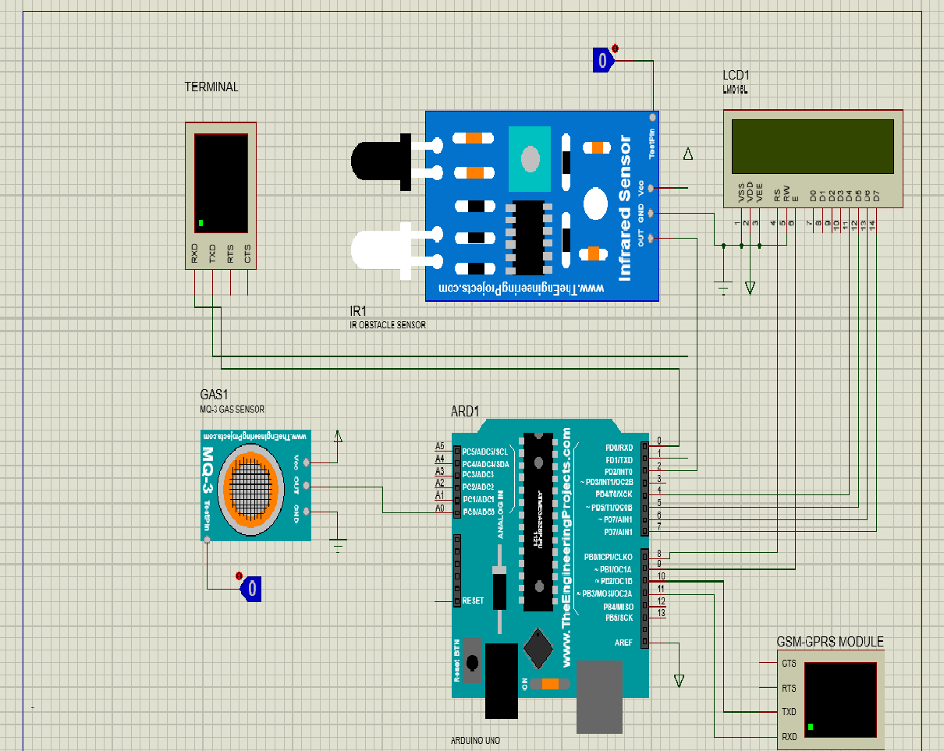
CIRCUIT DIAGRAM

Slide 11
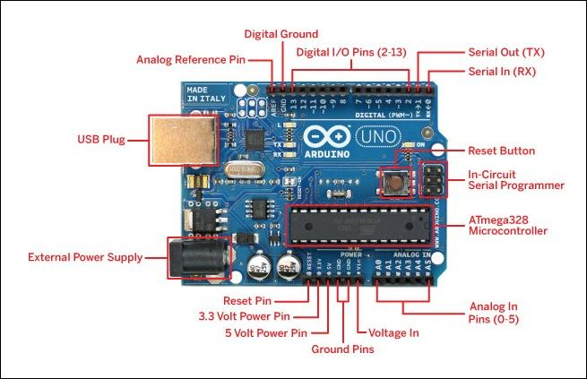
ARDUINO UNO

Slide 12
FEATURES OF ARDUINO UNO
Microcontroller: ATmega328
Operating Voltage: 5V
Input Voltage (recommended): 7-12V
Input Voltage (limits): 6-20V
Digital I/O Pins: 14 (of which 6 provide PWM output)
Analog Input Pins: 6
DC Current per I/O Pin: 40 mA
DC Current for 3.3V Pin: 50 mA
Flash Memory: 32 KB of which 0.5 KB used by bootloader
SRAM: 2 KB (ATmega328)
EEPROM: 1 KB (ATmega328)
Clock Speed: 16 MHz

Slide 13
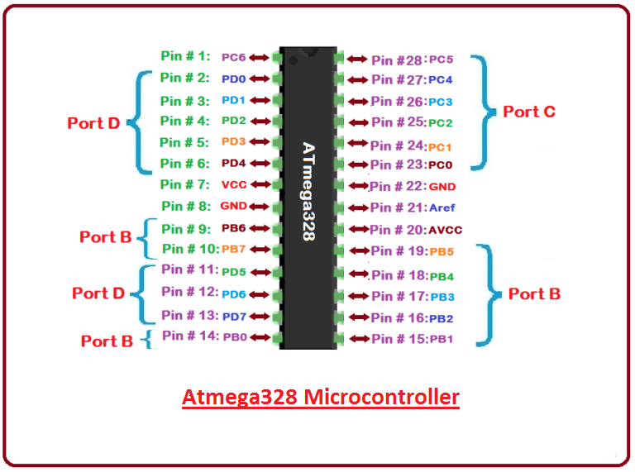
PIN DIAGRAM OF ATMEGA328

Slide 14
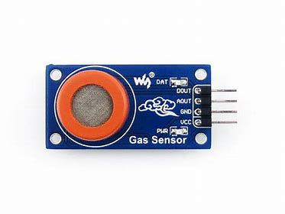
MQ-3 SENSOR
This module is made using Alcohol Gas Sensor MQ3. It is a low cost semiconductor sensor which can detect the presence of alcohol gases at concentrations from 0.05 mg/L to 10 mg/L.
The sensitive material used for this sensor is SnO2, whose conductivity is lower in clean air. It’s conductivity increases as the concentration of alcohol gases increases.
It has high sensitivity to alcohol and has a good resistance to disturbances due to smoke, vapor and gasoline.
This module provides both digital and analog outputs.

Slide 15
FEATURES OF MQ-3
Power requirements: 5 VDC
Current Consumption: 150mA
DO output: TTL digital 0 and 1 ( 0.1 and 5V)
AO output: 0.1- 0.3 V (relative to pollution), the maximum concentration of a voltage of about 4V
Detecting Concentration: 0.05-10mg/L Alcohol
Interface: 1 TTL compatible input , 1 TTL compatible output
Heater consumption: less than 750mW
Operating temperature: 14 to 122 °F
Load resistance: 200kΩ
Sensing Resistance Rs: 2KΩ-20KΩ
Dimensions: 32 x 22 x 16 mm

Slide 16
PIN DESCRIPTION OF MQ-3
PIN NAME | DESCRIPTION
VCC | This pin powers the module, typically the operating voltage is +5V
GND | Used to connect the module to system ground
DIGITAL OUT(DO) | You can also use this sensor to get digital output from this pin, by setting a threshold value using the potentiometer
ANALOG OUT(AO) | This pin outputs 0-5V analog voltage based on the intensity of the gas

Slide 17
MQ-3 INTERFACING WITH ARDUINO UNO
MQ-3 SENSOR | ARDUINO UO
VCC | +5V
GND | GND
ANALOG OUT | AO
DIGITAL OUT | NOT CONNECTED

Slide 18
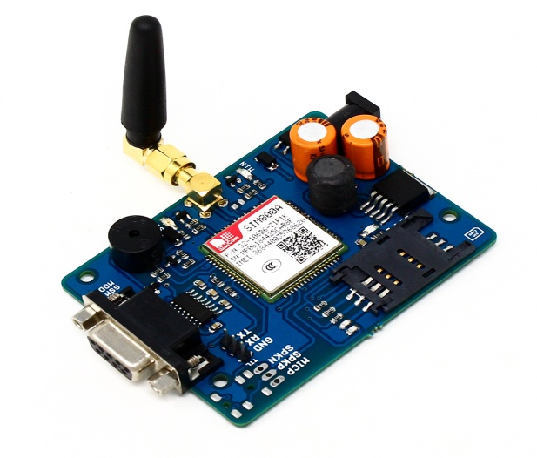
GSM800C MODULE
GSM SIM800C Modem with Antenna Module’s baud rate is configurable from 9600-115200 through AT command. The GSM GPRS Modem is having internal TCP/IP stack to enable you to connect with the internet via GPRS. It is suitable for SMS, Voice as well as DATA transfer applications in the M2M interface.
The Modem is built with Quad-Band GSM/GPRS engine-SIM800C from SIMCOM, works on frequencies 850/ 900/ 1800/ 1900 MHz. The Modem is populated with DB9 Female connector so as to directly connect with computer or other RS232 Compatible devices. MAX3232 from MAXIM Semiconductor is used for the RS232 Level conversion.

Slide 19
FEATURES OF GSM800C MODULE
Raspberry Pi connectivity, compatible with Raspberry Pi 2B/3B/3B+/Zero/Zero W
Supports SMS, GPRS, DTMF, HTTP, FTP, MMS, email, etc.
Bluetooth 3.0, supports data transferring through Bluetooth
2x LEDs for indicating the module working status
SIM card slot for 1.8V/3V SIM card
Baudrate auto detection (1200bps ~115200bps)
Control via AT commands
Supports SIM application toolkit: GSM 11.14 Release 99
Comes with development resources

Slide 20
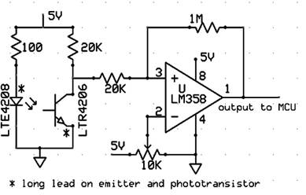
EYE BLINK SENSOR
Infrared sensor is a measure to give input signal to the system for defining the working of the whole system. An IR sensor consists of two parts: IR transmitter and IR receiver. IR Transmitter is also one type of LED uses to emit infrared rays similarly at receiving side the IR Receiver uses to receive the IR rays transmitted by IR transmitter and both IR transmitter and receiver should be placed within a line.
IR Sensors operate by detecting bounced infrared light. The LTE4208 IR emitter is the source of the infrared light and bounced light intensity is detected by the LTR4206 phototransistor. The variation in current is put into a comparator (composed of the LM358 and the 10k trimpot), which will raise the signal to the MCU.

Slide 21
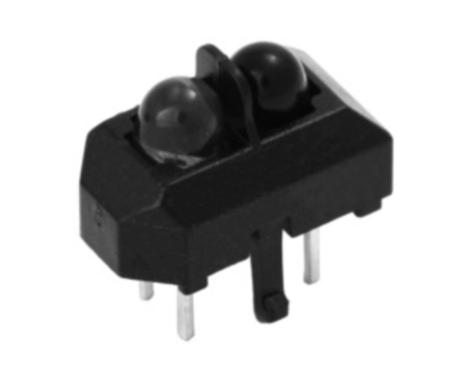
TCRT5000
The TCRT5000 and TCRT5000L are reflective sensors which include an infrared emitter and phototransistor in a leaded package which blocks visible light. The package includes two mounting clips. TCRT5000L is the long lead version.
FEATURES OF TCRT:
Package type: leaded
• Detector type: phototransistor
• Dimensions (L x W x H in mm): 10.2 x 5.8 x 7
• Peak operating distance: 2.5 mm
• Operating range within > 20 % relative collector
Current: 0.2 mm to 15 mm
• Typical output current under test: IC = 1 mA
• Daylight blocking filter
• Emitter wavelength: 950 nm

Slide 22
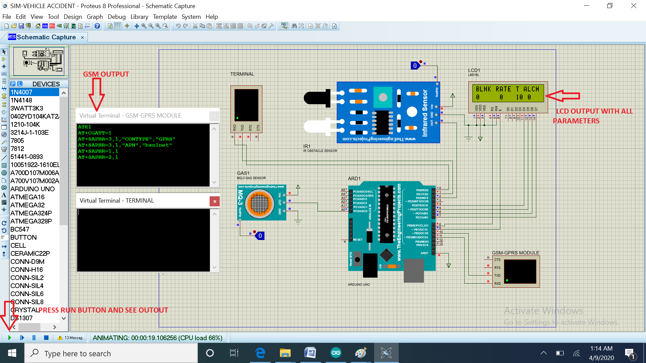
OUTPUT OF PROTEUS SIMULATION

Slide 23
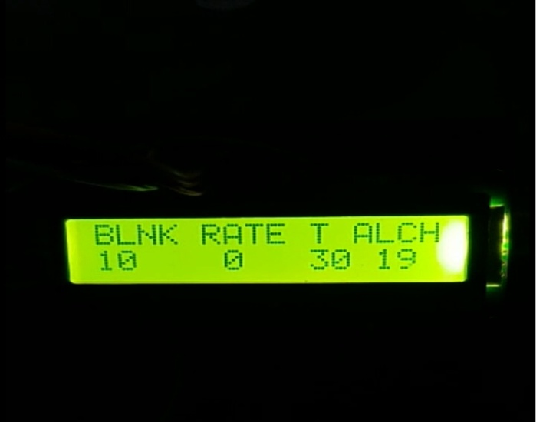
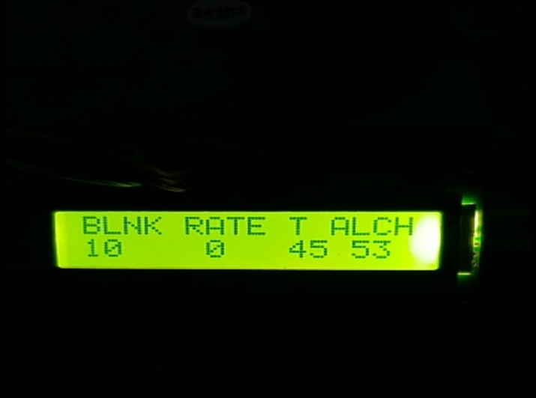
HARDWARE OUTPUT
LCD OUTPUT
OUTPUT 1-WHEN EYE BLINKS 10 TIMES AND ALCOHOL LEVEL NORMAL
OUTPUT 2-WHEN ALCOHOL LEVEL HIGH

Slide 24
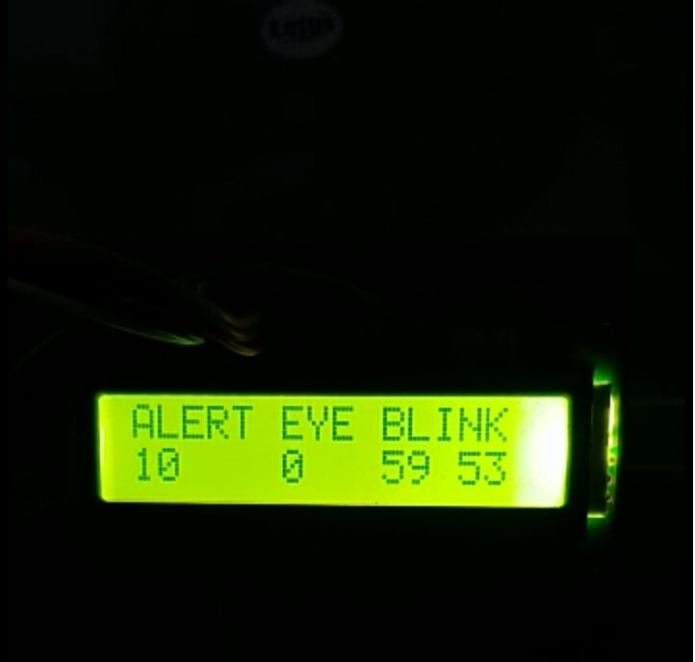
OUTPUT 3-ALERT OUTPUT FOR LESS EYE BLINK

Slide 25
FUTURE SCOPE:
This project can be further enhanced by involving the features of automatic blow the air bag and lock the brakes, also at the theft event of vehicle stop the engine remotely through GSM system.
Also in this project we can add a Vibrator sensor is used to sense the abnormal vibration occurs inside a vehicle at any accident situation.
APPLICATIONS
stolen vehicle recover: -both consumer and commercial vehicles can be outfitted with GPS unit to allow police to do tracking and recovery.
Automatic safety purpose: this project can be further enhanced by providing more features of automatic blow air bag and lock the brakes.
Transit tracking:- this is a temporary tracking of assets or cargoes from one point to another. Users will ensure that the assets do not stop on route.

Slide 26
CONCLUSION
This project presents the vehicle accident avoiding and alert system by sending sms through GSM module to user defined mobile number .the GPS tracking and gsm alert based algorithm is designed and implemented with atmega328 microcontroller .the proposed vehicle accident detection system can track geographical information automatically and sends an alert sms. This is also includes the various sensors like alcohol sensor which sense the alcohol level and display the output on lcd screen and another another one is eye blink sensor which indicates the situation of our eyes blinking rates and display the alert output on lcd screen

Slide 27
THANK YOU

